Slide 1
Network Simulator:
NS-3
Kameswari Chebrolu
Reference: https://www.nsnam.org/tutorials/simutools08/ns-3-tutorial-slides.ppt
https://www.nsnam.org/docs/release/3.2/tutorial/tutorial_18.html

Slide 2
Motivation for Simulations
Cheap -- does not require costly equipment
Complex scenarios can be easily tested
Results can be quickly obtained – more ideas can be tested in a smaller timeframe
The real thing isn't yet available
Controlled experimental conditions
  Repeatability helps aid debugging
Disadvantages: Real systems too complex to model

Slide 3
Features of NS-3
Protocols: Propagation Models, 802.11 MAC , OSLR, TCP, UDP, OnOff Applicaton, Socket apis etc
Ns3 library written in C++; Simulations are c++ executables; bindings in Python
ns-3 uses the waf build system i.e., instead of ./configure;make, type ./waf
Alignment with real systems (sockets, device driver interfaces)‏
Alignment with input/output standards (pcap traces, ns-2 mobility scripts)‏
Modular, documented core

Slide 4
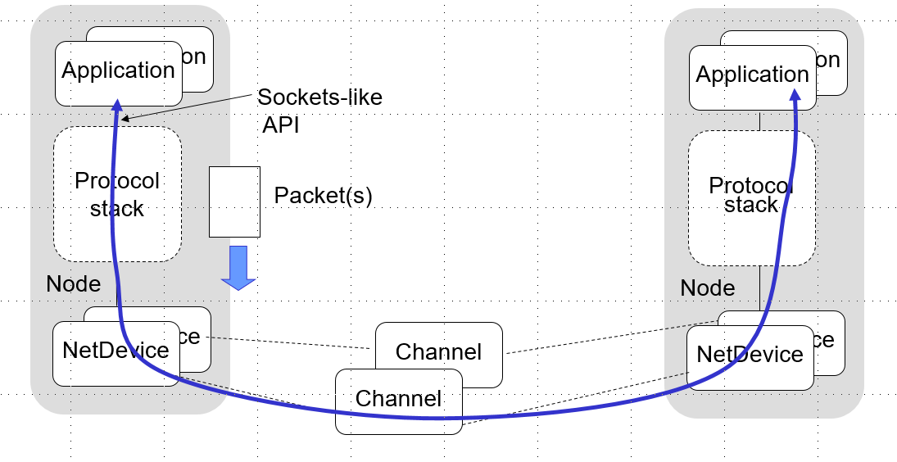


Slide 5
Simulation Basics
Simulation time moves discretely from event to event
C++ functions schedule events to occur at specific simulation times
A simulation scheduler orders the event execution
Simulation::Run() gets it all started
Simulation stops at specific time or when events end

Slide 6
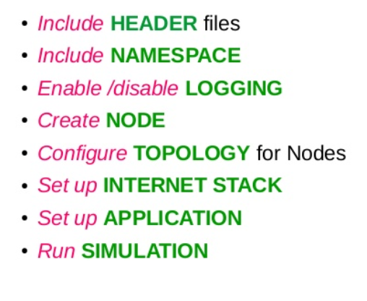
Main Program Structure

Slide 7
Code Walk Through

